Slide 1
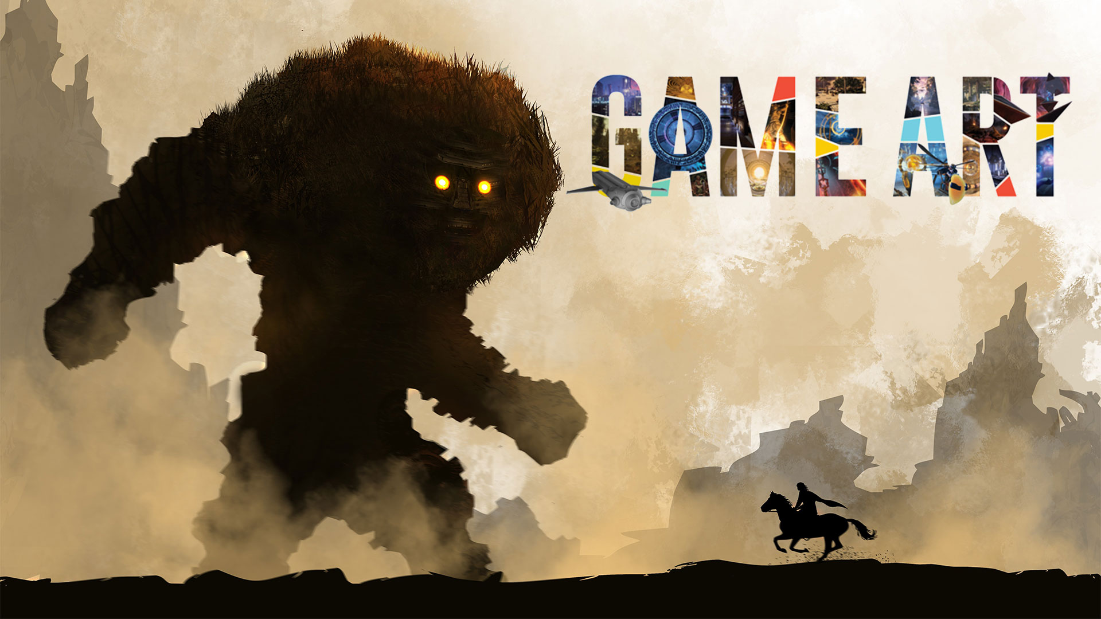

Slide 2
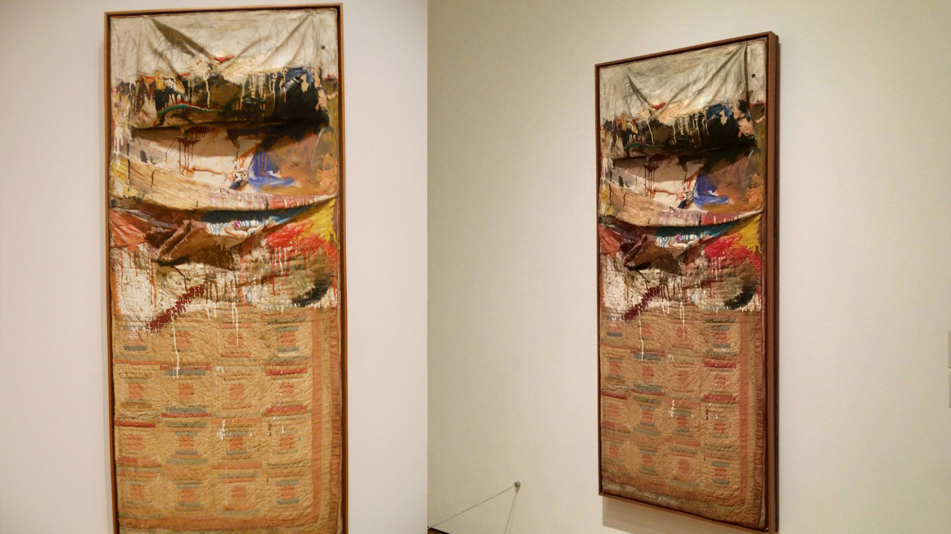
Rauschenberg's Bed

Slide 3
Imitation Theory

Slide 4
Abstractionism

Slide 5
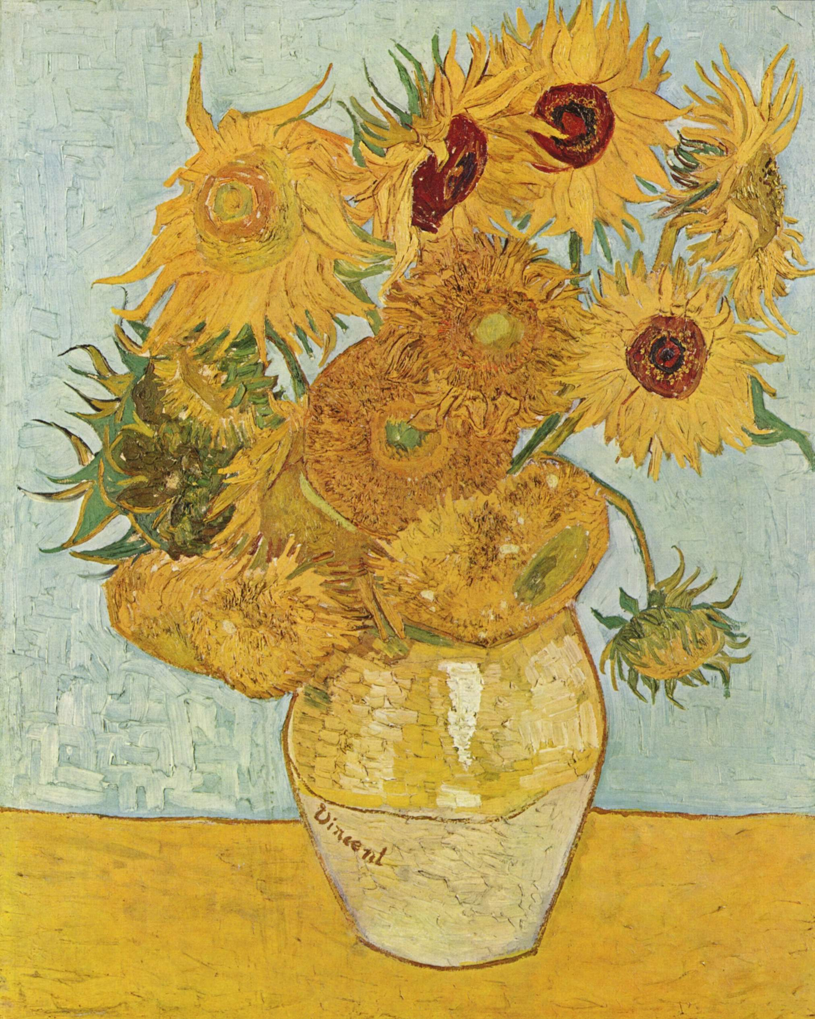
Sunflower

Slide 6
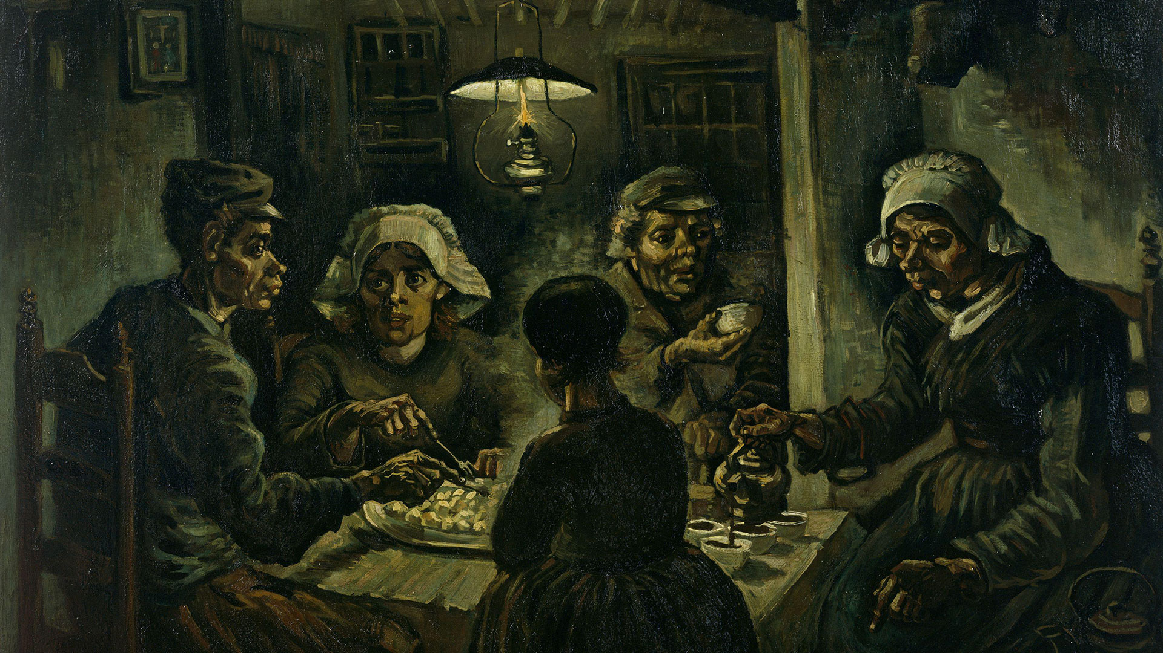
Potato Eater

Slide 7
Realistic Theory

Slide 8
Impressionism

Slide 9
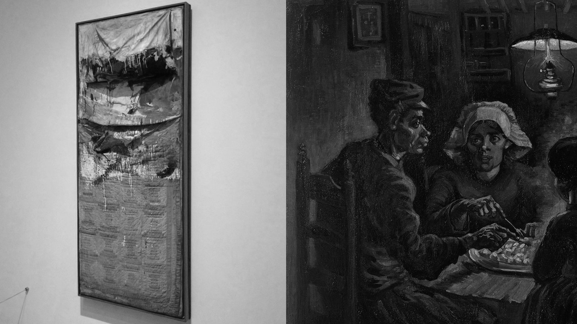
Abstractionism vs Impressionism

Slide 10


Slide 11
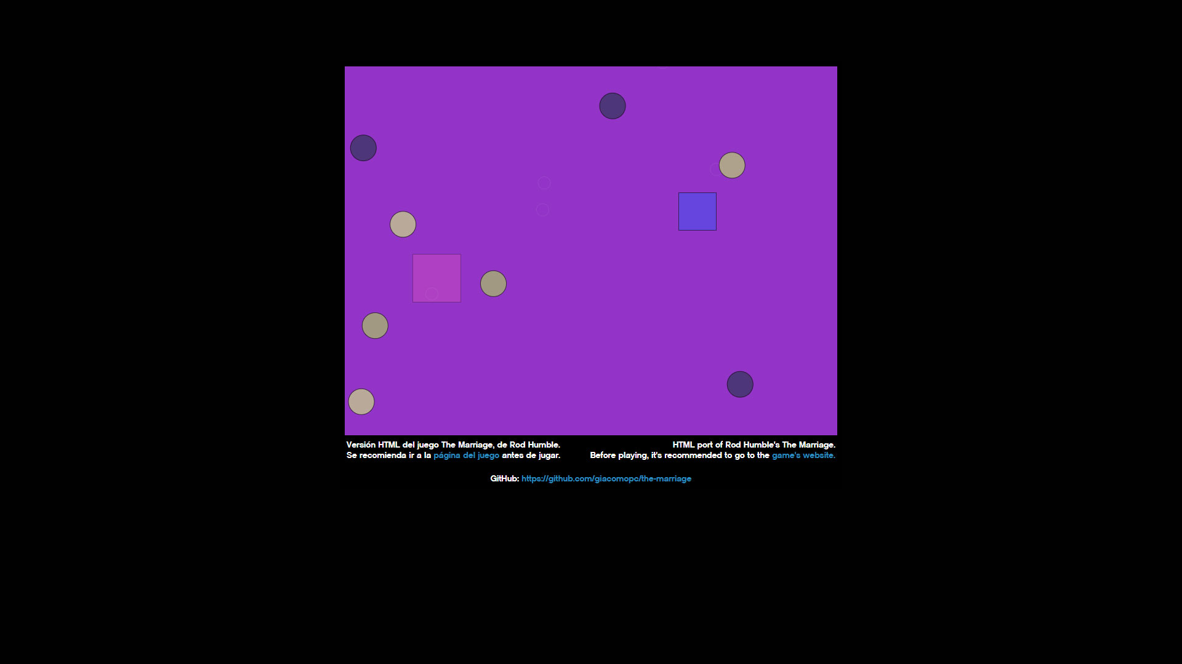

Slide 12
Abstractionism

Slide 13


Slide 14
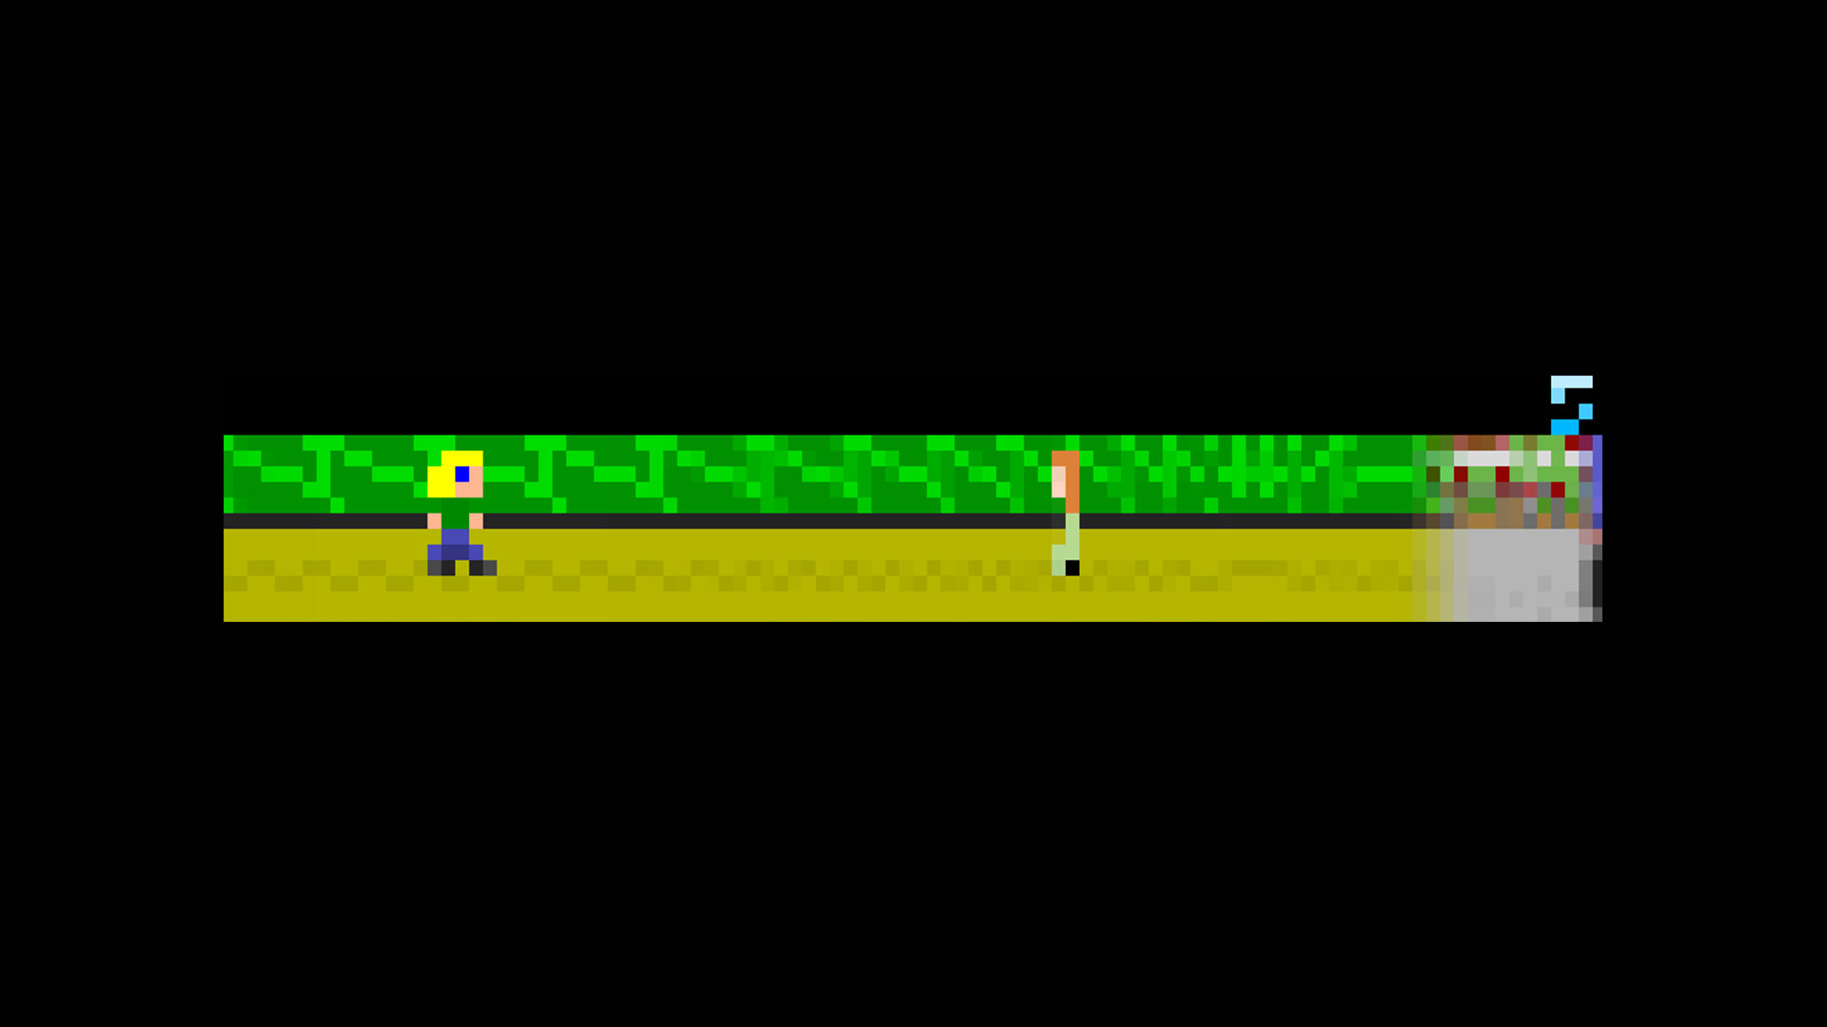

Slide 15
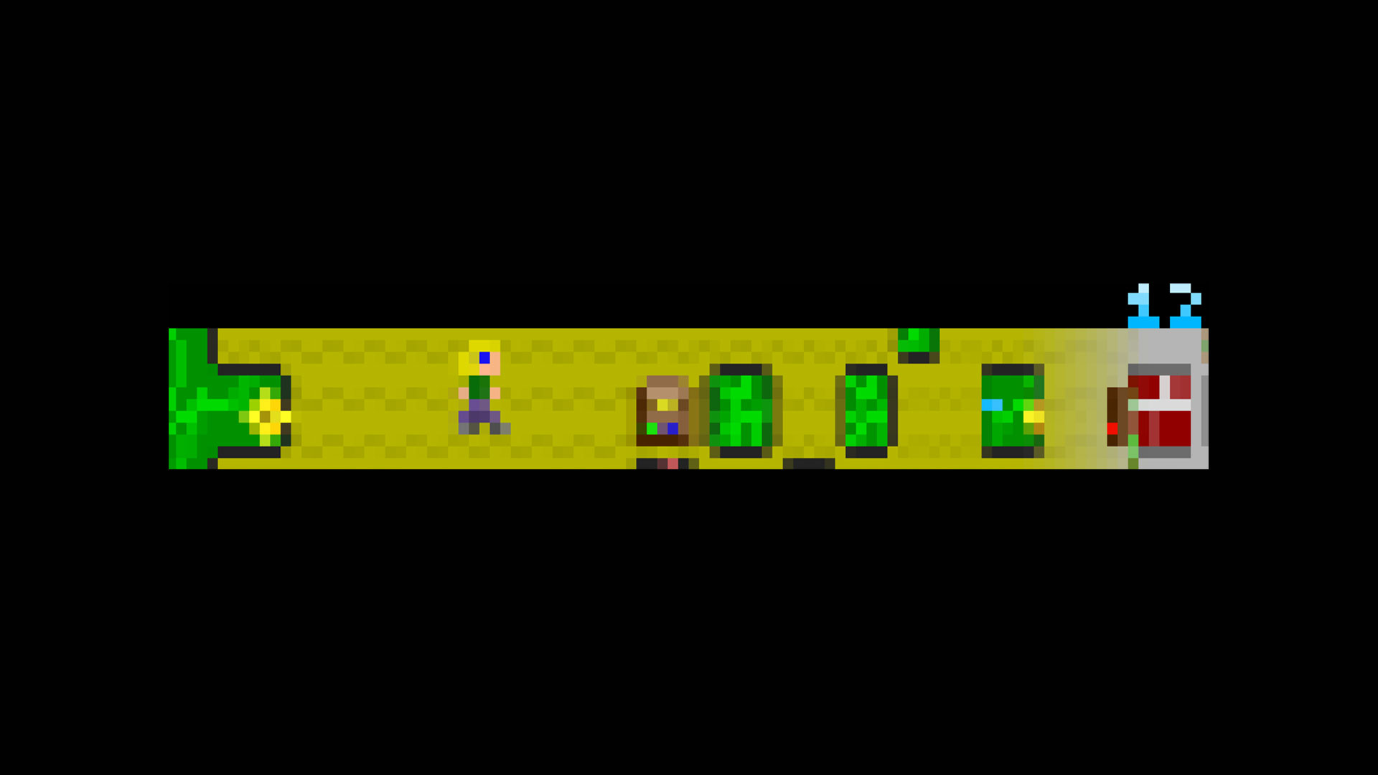

Slide 16
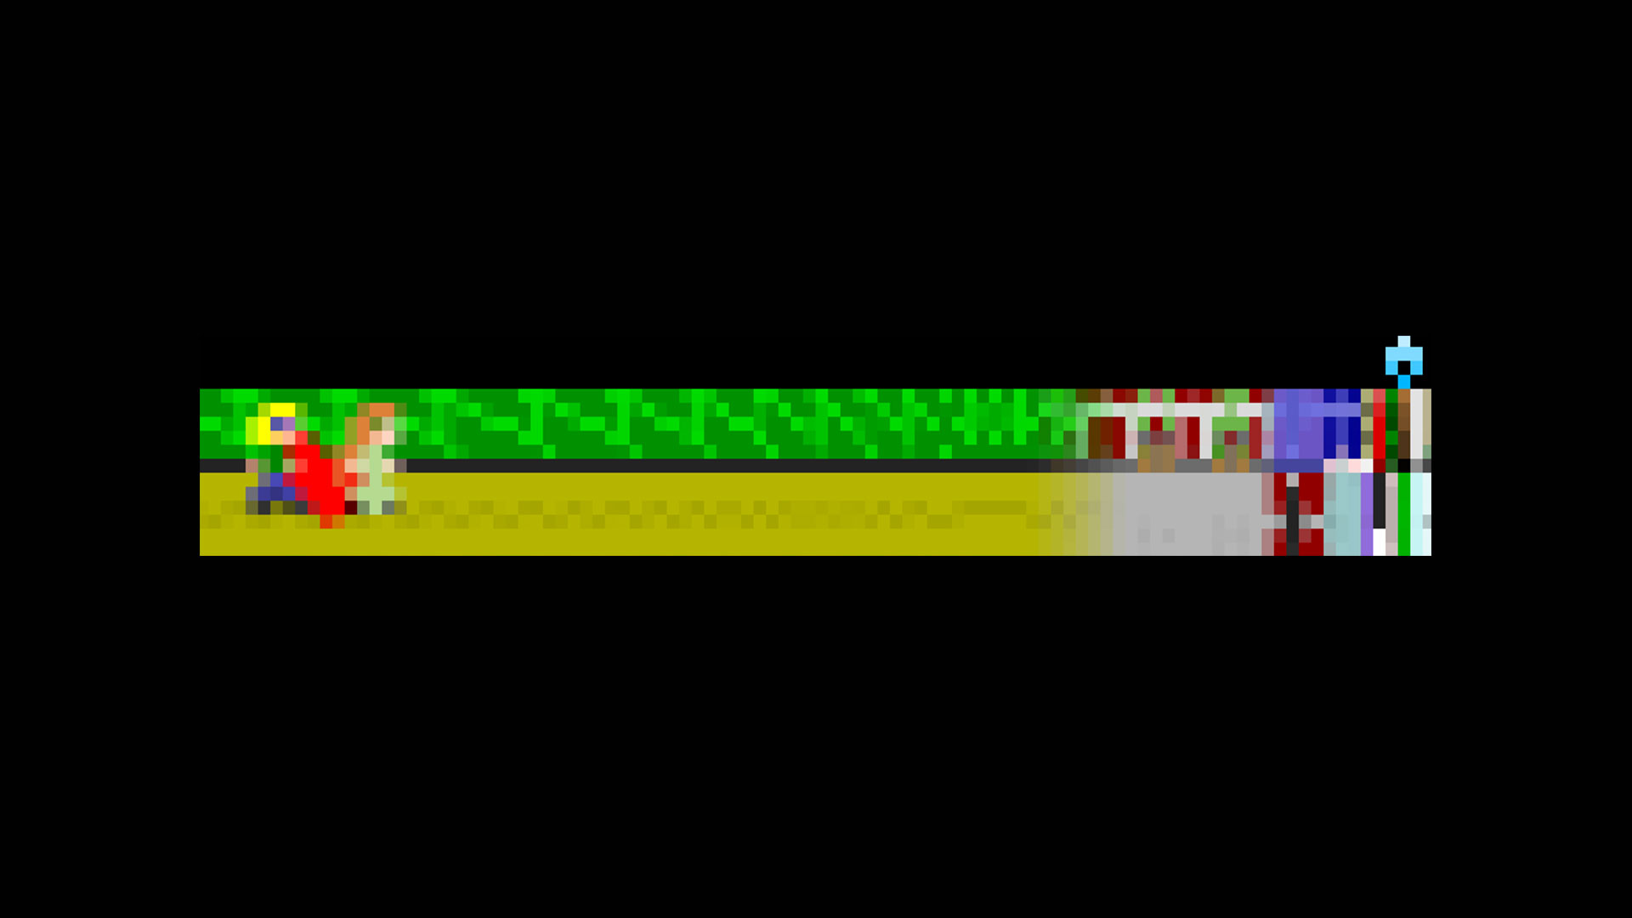

Slide 17


Slide 18
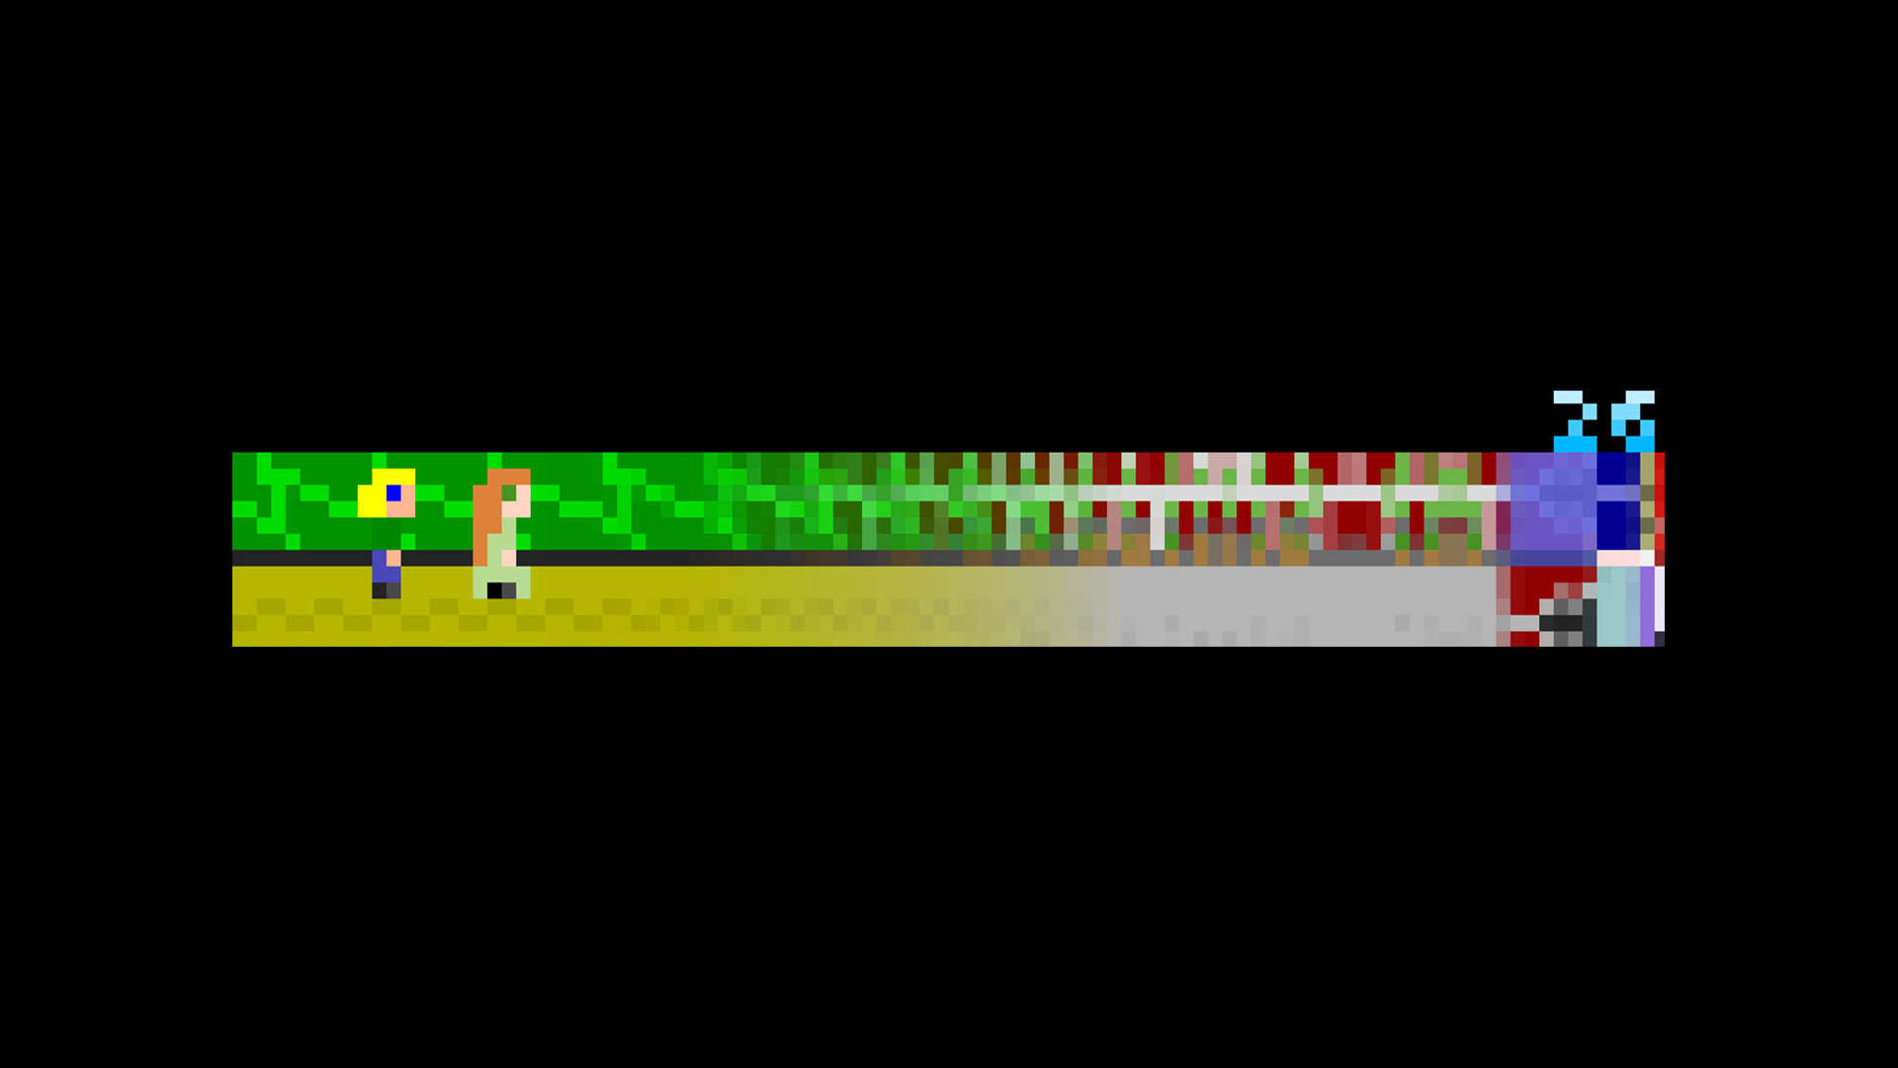

Slide 19
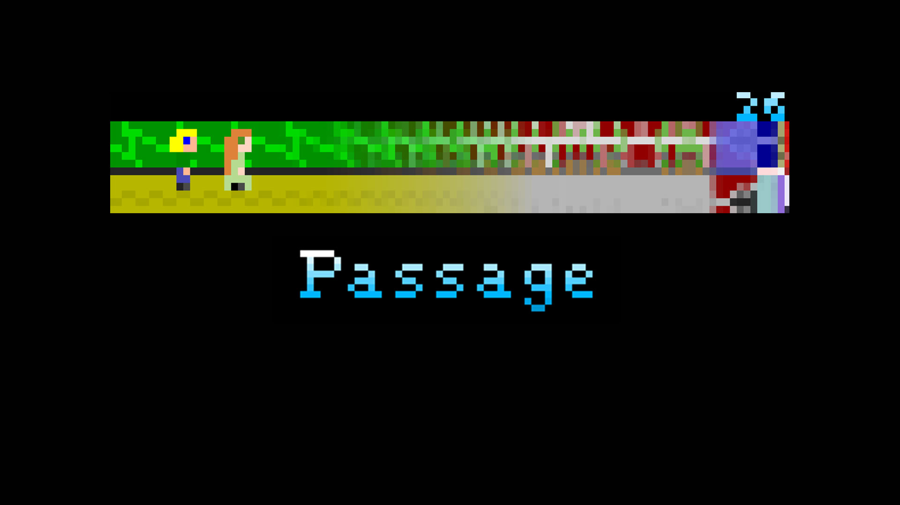
Impressionism

Slide 20
Emotionally Powerful

Slide 21
Art are Key Factors

Slide 22
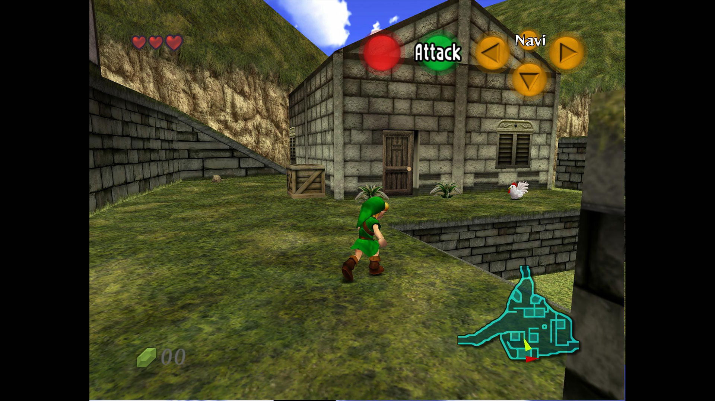
The Legend of Zelda: Ocarina of Time

Slide 23
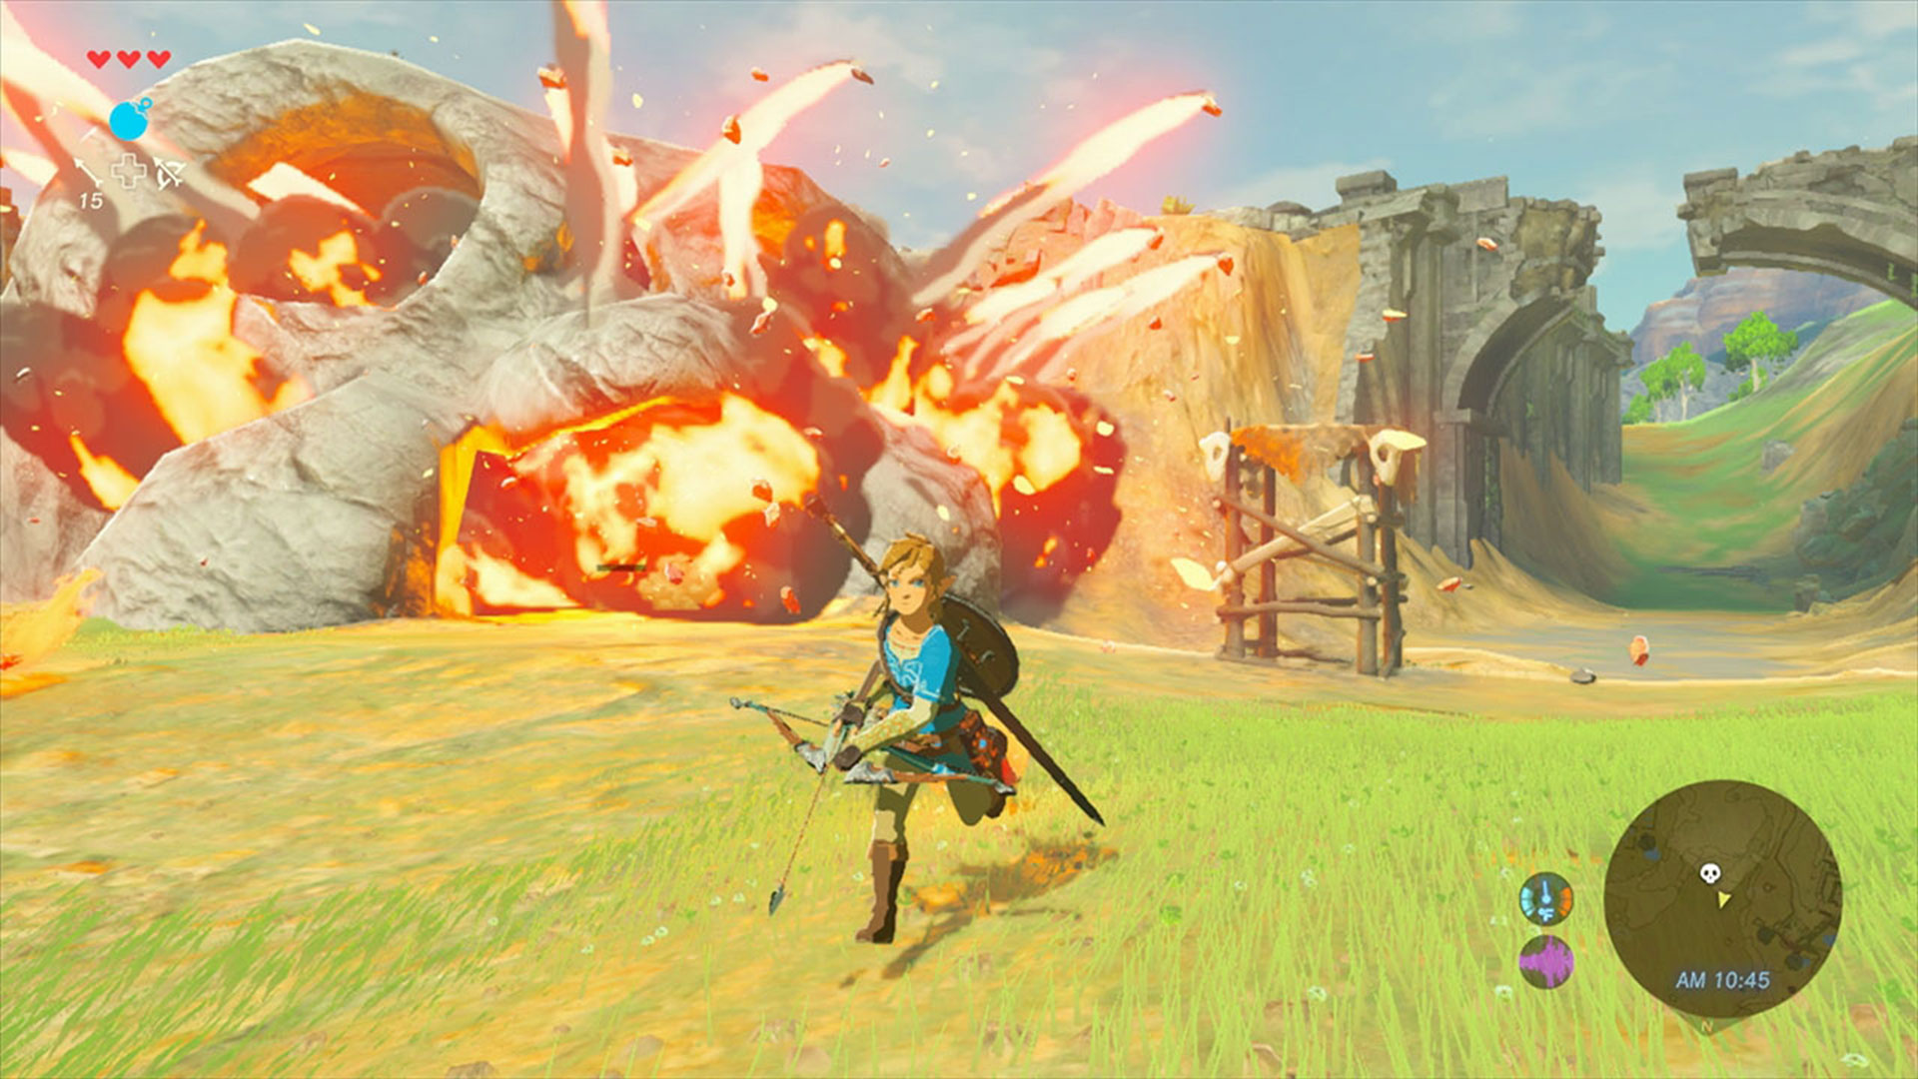
The Legend of Zelda: Breath of the Wild

Slide 24

Grand Theft Auto III

Slide 25

Grand Theft Auto V

Slide 26
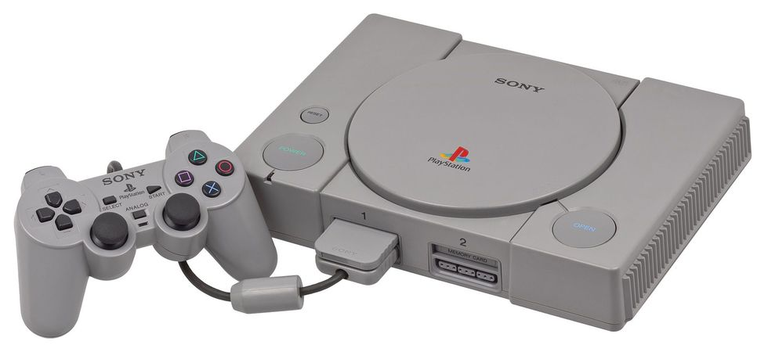

Slide 27
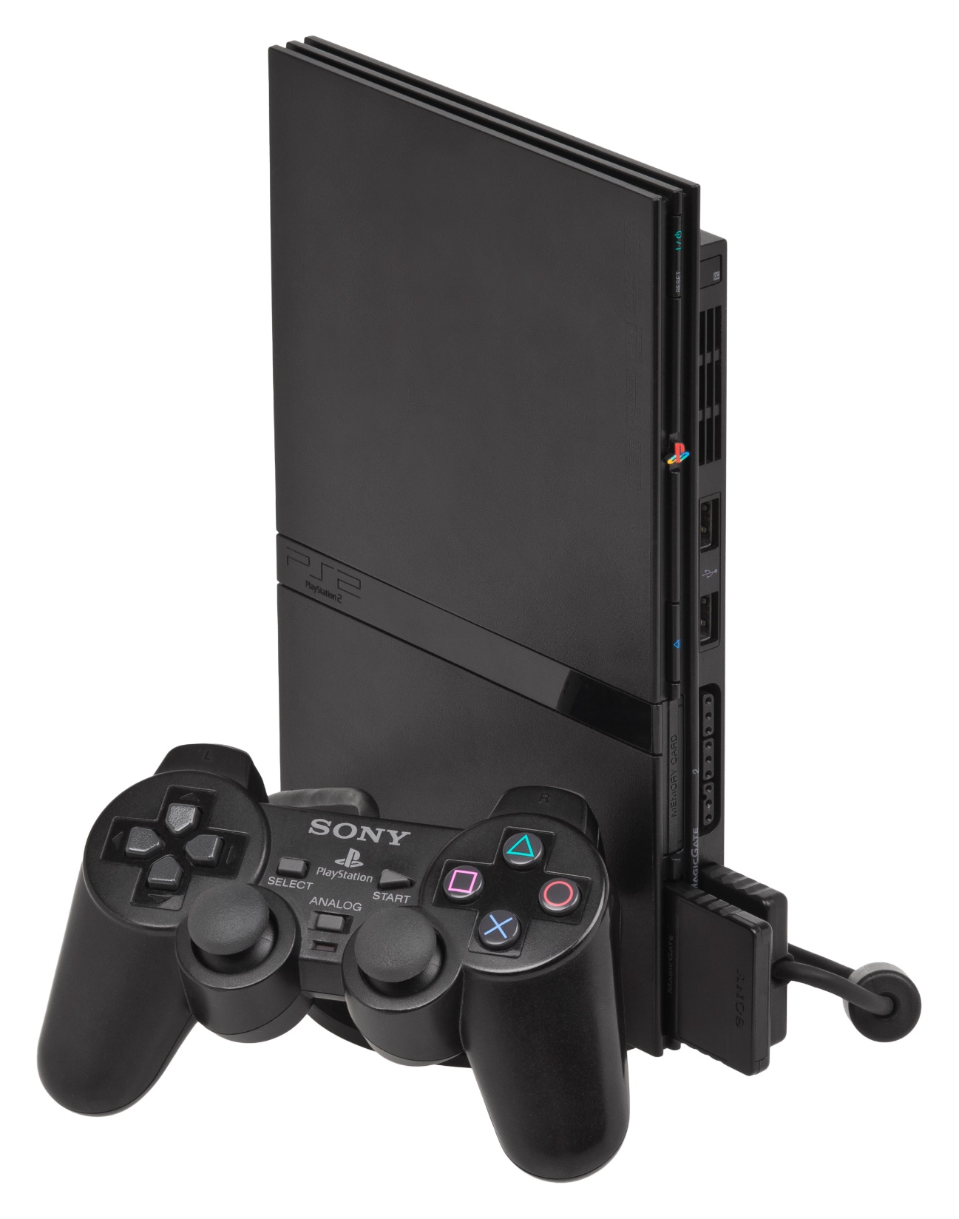

Slide 28
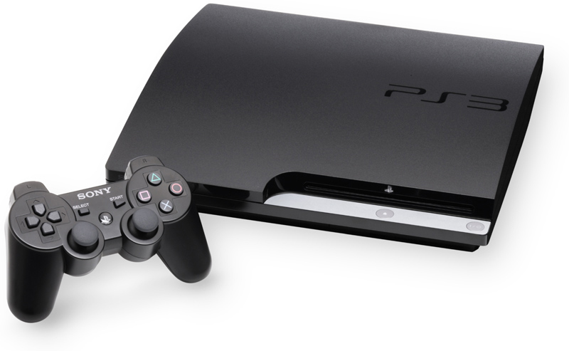

Slide 29
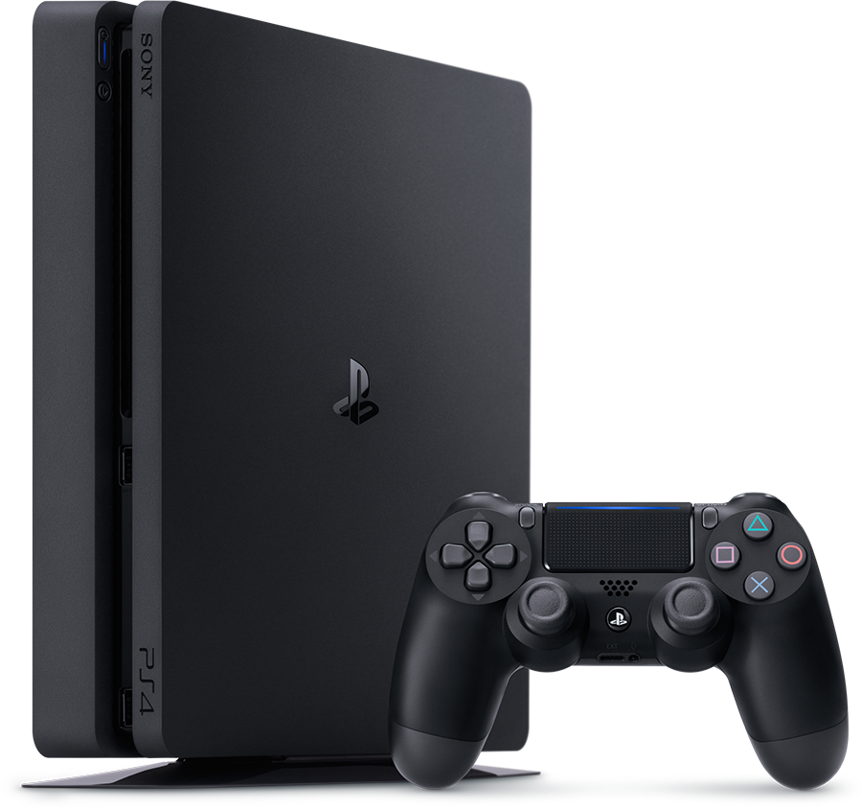

Slide 30


Slide 31
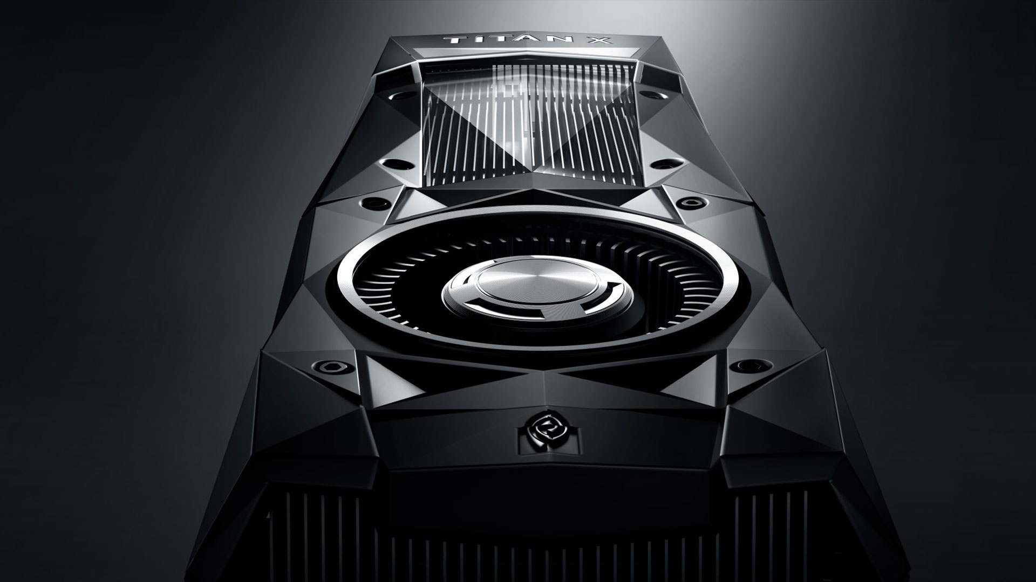

Slide 32
Art Pushing Industry Forward

Slide 33
Abstractionism vs Impressionism;
Art is Key Factor for a Game;
Art pushing Industry Forward;

